Slide 1
Cooperating Threads and Synchronization
Xin Liu
xl24j@fsu.edu
COP 4610 Operating Systems

Slide 2
Teaching Assistants
Teaching Assistant 1: Michael Nguyen
Office Hours: Friday, 1:00 PM – 4:00 PM, Major Lab.
Teaching Assistant 2: Bing Jiao
Office Hours: Tuesday, 2:00 PM – 5:00 PM, Major Lab.

Slide 3
Outline
Independent Threads
Cooperating Threads
Race Condition
Loss of Atomicity
Synchronization

Slide 4
Process
An address space + at least one thread of execution
Address space offers protection among processes
Threads offer concurrency
A fundamental unit of computation

Slide 5
This Is How Simple Operating Systems Are!
CPU Reset
Firmware (BIOS/UEFI)
Boot Loader (MBR, LILO/GRUB)
Kernel_start()
Use ls /sbin/init -l to check if systemd is being used
Read Latest Linux Kernel Code:
https://elixir.bootlin.com/linux/v6.10.9/source/init/main.c#L1523
Process 1
Process Management
fork, exec, and exit
Memory Management
mmap –virtual address space
File management
open, close, read, write
mkdir, link, unlink
Application Program (state machine)
+
system call
Process
Management
Memory
Management
File
Management
You can use system call to create the world!

Slide 6
Thread
A sequential execution stream
The smallest CPU scheduling unit
Can be programmed as if it owns the entire CPU
Implication: an infinite loop within a thread won’t halt the system
Illusion of multiple CPUs on a single-CPU machine

Slide 7

Concurrency
Allows multiple applications to run at the same time
Analogy: juggling

Slide 8
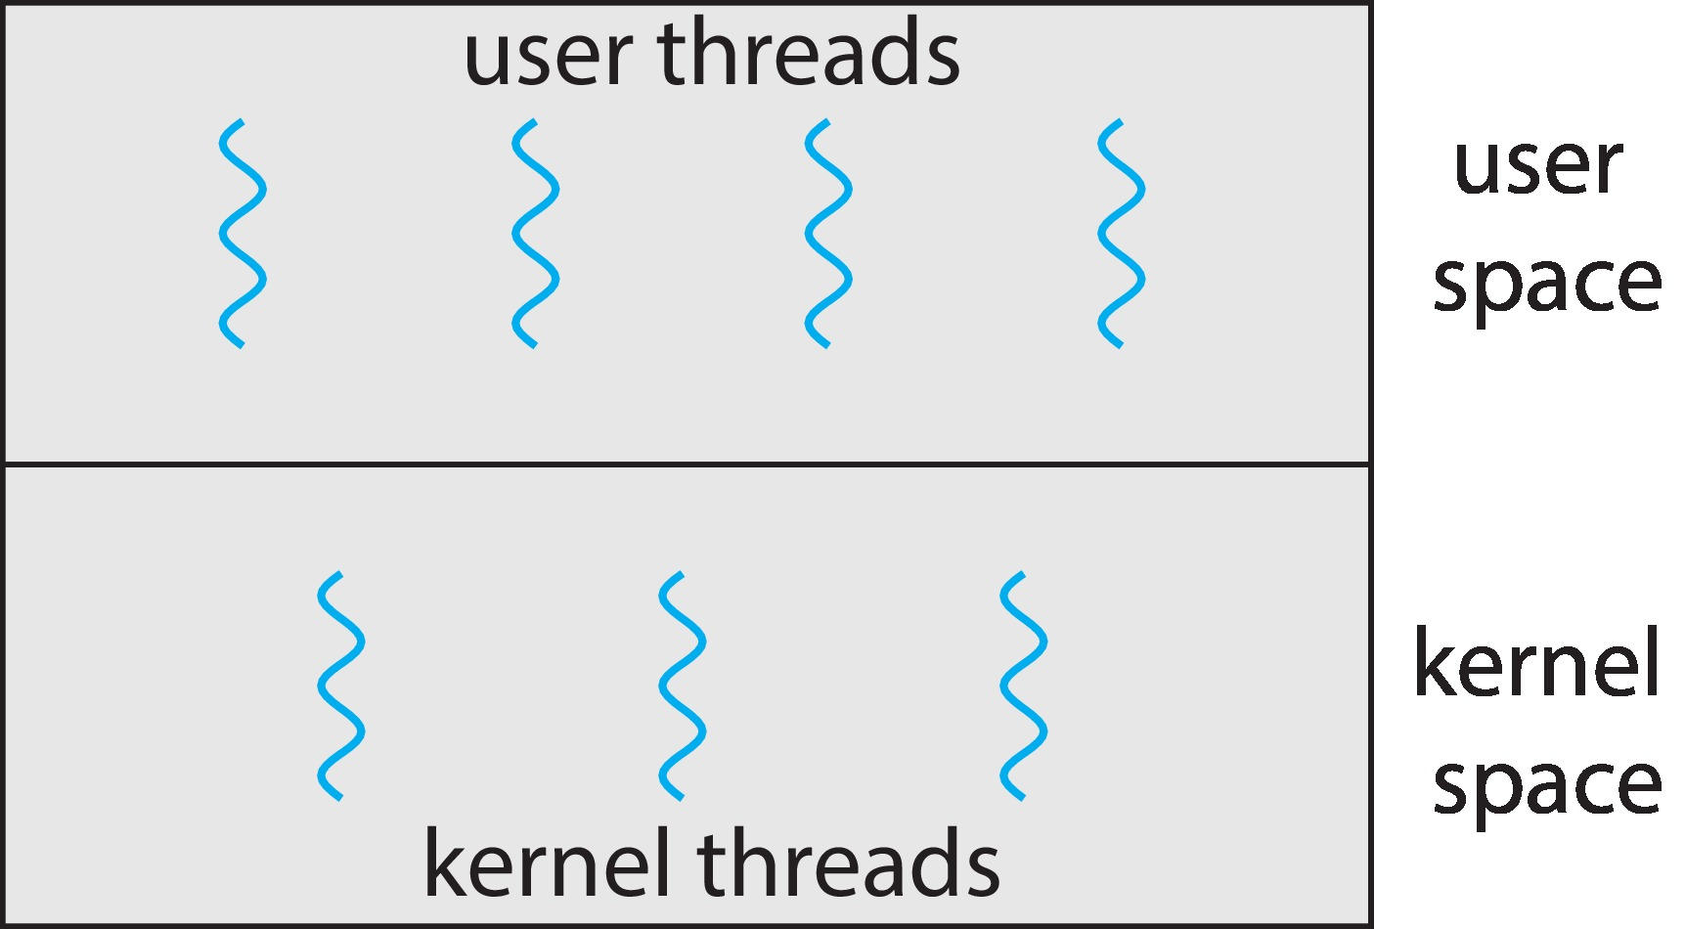
User and Kernel Threads

Slide 9
Independent Threads
No states shared with other threads
Deterministic computation
Output depends solely on the input
Same input always produces the same output
Reproducible
Output does not depend on the order and timing of other threads
Scheduling order does not matter

Slide 10
Pthreads
May be provided either as user-level or kernel-level
A POSIX standard (IEEE 1003.1c) API for thread creation and synchronization
Specification, not implementation
API specifies behavior of the thread library, implementation is up to development of the library
Common in UNIX operating systems (Linux & Mac OS X)
pthread.h defines the interface for pthreads

Slide 11
Pthreads Example (Cont.)
#include <pthread.h>
#include <stdio.h>
#include <stdlib.h>
void *Ta(void *arg) {
while (1) {
printf("a");
}
return NULL;
}
void *Tb(void *arg) {
while (1) {
printf("b");
}
return NULL;
}
int main() {
pthread_t thread1, thread2;
if (pthread_create(&thread1, NULL, Ta, NULL) != 0) {
fprintf(stderr, "Failed to create thread1\n");
exit(1);
}
if (pthread_create(&thread2, NULL, Tb, NULL) != 0) {
fprintf(stderr, "Failed to create thread2\n");
exit(1);
}
pthread_join(thread1, NULL);
pthread_join(thread2, NULL);
return 0;
}

Slide 12
Pthreads Example (Cont.)
The program utilizing pthread.h can be written to take advantage of multiple processors!
The operating system will automatically place threads on different processors.
When running in the background, you can observe the CPU usage exceeding 100%.

Slide 13
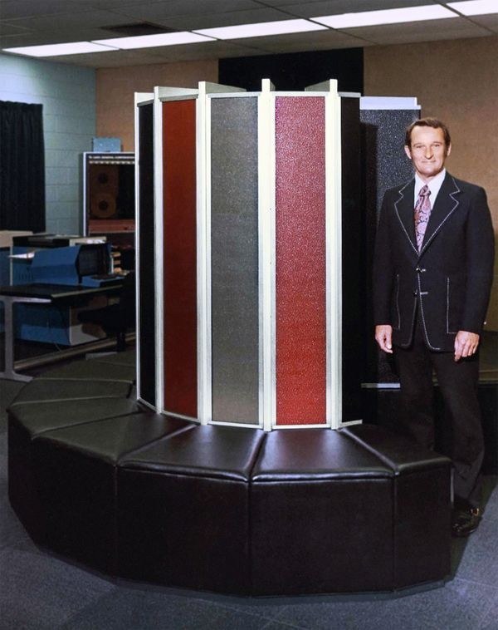
Concurrent Programming in HPC
The World’s Most Expensive Sofa
The First Supercomputer (1976)
Single-processor system
138 million FLOPs (Floating Point Operations per Second)
40 times faster than IBM 370 at the time
Slightly better than embedded chips today
Processed large data sets with one instruction

Slide 14
Features of HPC
“A technology that harnesses the power of supercomputers or computer clusters to solve complex problems requiring massive computation.”
(IBM)
Computation-Centric
System Simulation: Weather forecasting, energy, molecular biology
Artificial Intelligence: Neural network training
Mining: Pure hash computation
TOP 500 (https://www.top500.org/)
1st: Frontier (8, 699,904 cores, 1206 PFLOS)

Slide 15
Main Challenges of HPC
How to Break Down Computation Tasks?
Computation Graphs need to be easy to parallelize
Task decomposition happens on two levels: machine and thread
Parallel and Distributed Computation: Numerical Methods
How Do Threads Communicate?
Communication happens not only between nodes/threads but also with any shared memory access
MPI - "a specification for developers and users of message-passing libraries"
OpenMP - "multi-platform shared-memory parallel programming in C/C++ and Fortran“

Slide 16



Example: Mandelbrot Set
Each point in the Mandelbrot set iterates independently and is only influenced by its complex coordinate

Slide 17
Cooperating Threads
Shared states (address space -> memory)
The Root of All Evil
Nondeterministic
Output depends on input and other factors
Nonreproducible
Same input can produce different outputs in different runs
Influenced by factors such as thread scheduling, randomness, or external environment

Slide 18
Example: Share Memory
#include <pthread.h>
#include <stdio.h>
#include <stdlib.h>
#include <unistd.h>
#define NTHREAD
int x = 0;
pthread_t threads[NTHREAD];
void *Thello(void *arg) {
int id = *(int *)arg;
usleep(id * 100000);
printf("Hello from thread #%c\n", "123456789ABCDEF"[x++]);
return NULL;
}
int main() {
int ids[NTHREAD];
for (int i = 0; i < NTHREAD; i++) {
ids[i] = i + 1;
if (pthread_create(&threads[i], NULL, Thello, &ids[i]) != 0) {
fprintf(stderr, "Error creating thread %d\n", i);
return 1;
}
}
for (int i = 0; i < NTHREAD; i++) {
pthread_join(threads[i], NULL);
}
return 0;
}

Slide 19
Example: Share Memory
#include <pthread.h>
#include <stdio.h>
#include <stdlib.h>
#include <unistd.h>
#define NTHREAD
int x = 0;
pthread_t threads[NTHREAD];
void *Thello(void *arg) {
int id = *(int *)arg;
usleep(id * 100000);
printf("Hello from thread #%c\n", "123456789ABCDEF"[x++]);
return NULL;
}
int main() {
int ids[NTHREAD];
for (int i = 0; i < NTHREAD; i++) {
ids[i] = i + 1;
if (pthread_create(&threads[i], NULL, Thello, &ids[i]) != 0) {
fprintf(stderr, "Error creating thread %d\n", i);
return 1;
}
}
for (int i = 0; i < NTHREAD; i++) {
pthread_join(threads[i], NULL);
}
return 0;
}

Slide 20
So, Why Allow Cooperating Threads?

Slide 21
So, Why Allow Cooperating Threads?
Shared resources
e.g., a single processor
Speedup
Occurs when threads use different resources at the same times
Modularity
An application can be decomposed into threads

Slide 22
However, Something Terrifying is Approaching..
In a multiprocessor system, threads may execute code simultaneously.
What will happen if two threads execute x++ at the same time?

Slide 23
Atomic Operations
Atomicity refers to an operation or a sequence of operations that either completes fully or does not execute at all, without being interrupted by other operations during execution.
It guarantees the indivisibility of an operation, ensuring that it cannot be partially completed or interrupted by another thread or process
Key Characteristics:
Indivisibility: Atomic operations cannot be divided; no other thread or process can see or modify the operation's intermediate state.
Completeness: An atomic operation either fully succeeds and completes all its tasks, or it does not execute at all. There is no partial state.
No Interference: In a multi-threaded environment, atomic operations are not affected or interrupted by other threads.

Slide 24
Examples of Atomic Operations
Simple Operation:
On most processors, an operation like int x = 1; is atomic because it involves a single memory action that cannot be interrupted.
Non-Atomic Operation:
Operations like x++ involve multiple steps:
Read the current value of x.
Increment x by 1.
Write the new value back to x.

Slide 25
Some Concurrent Programs
If threads share data, the final values are not as obvious
Thread A Thread B
x = 1; y = 2;
x = y + 1; y = y * 2;
What are the indivisible operations?

Slide 26
All Possible Execution Orders
Thread A Thread B
x = 1; y = 2;
x = y + 1; y = y * 2;
(x = 0, y = 0)
x = 1
y = 2
x = y + 1
y = 2
x = 1
y = y * 2
y = 2
x = y + 1
y = y * 2
x = 1
y = y * 2
y = y * 2
x = y + 1
x = y + 1
A decision tree

Slide 27
All Possible Execution Orders
Thread A Thread B
x = 1; y = 2;
x = y + 1; y = y * 2;
(x = 0, y = 0)
(x = 1, y = 0)
(x = 0, y = 2)
x = 1
y = 2
(x = 1, y = 0)
(x = 1, y = 2)
(x = 0, y = 4)
x = y + 1
y = 2
x = 1
y = y * 2
(x = 1, y = 2)
(x = 3, y = 2)
(x = 1, y = 4)
(x = 1, y = 4)
y = 2
x = y + 1
y = y * 2
x = 1
y = y * 2
y = y * 2
x = y + 1
x = y + 1
(x = 1, y = 4)
(x = 3, y = 4)
(x = 5, y = 4)
(x = 5, y = 4)

Slide 28
Race Condition
Race conditions occur when threads share data, and their results depend on the timing of their execution.
If we replace the x++ operation in C with a single assembly instruction…
The atomicity of the operation is lost, as x++ is not a single instruction but a series of steps (load, increment, store).
Can this lead to race conditions in multithreaded environments?
The atomicity of the operation is still lost.

Slide 29
Loss of Atomicity in Modern Multiprocessor Systems
The basic assumption that "a program (or even a single instruction) exclusively executes on the processor" no longer holds true in modern multiprocessor systems.
Single Processor, Multithreading:
A thread may be interrupted and switched to another thread during execution.
Multiprocessor, Multithreading:
Threads are executed truly in parallel.
Historical Context (1960s):
There was a race to implement atomicity (mutual exclusion) in shared memory systems.
Almost all implementations were flawed until Dekker's Algorithm, which could only ensure mutual exclusion between two threads.

Slide 30
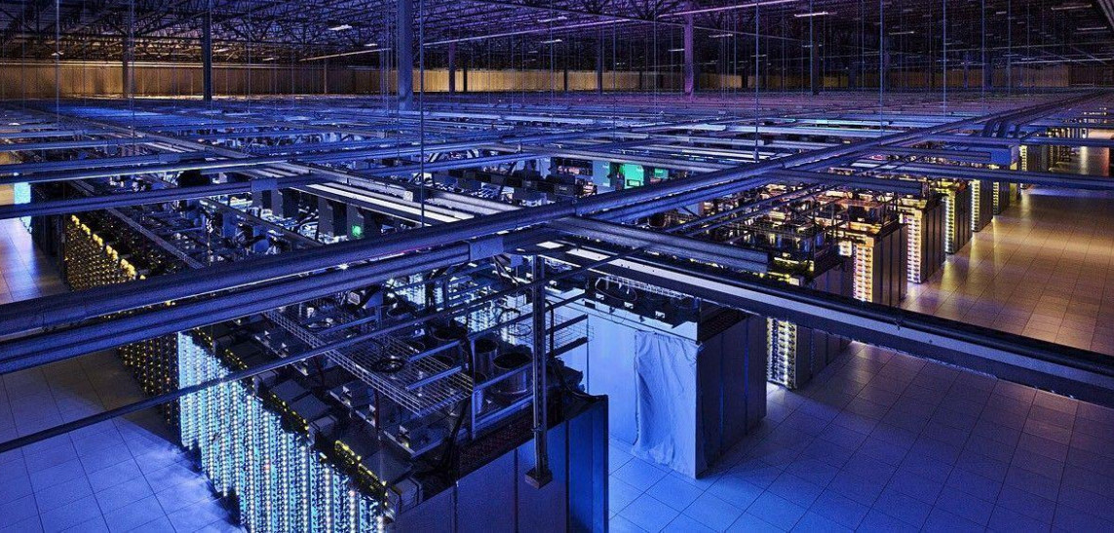
Concurrent Programming in Data Centers
Google Data Center

Slide 31
Features of Data Center
“A network of computing and storage resources that enable the delivery of shared applications and data.”
(CISCO)
Data-Centric (Storage-Focused) Approach
Originated from internet search (Google), social networks (Facebook/Twitter)
Powers various internet applications: Gaming/Cloud Storage/ WeChat/Alipay/...
The Importance of Algorithms/Systems for HPC and Data Centers
You manage 1,000,000 servers
A 1% improvement in an algorithm or implementation can save 10,000 servers

Slide 32
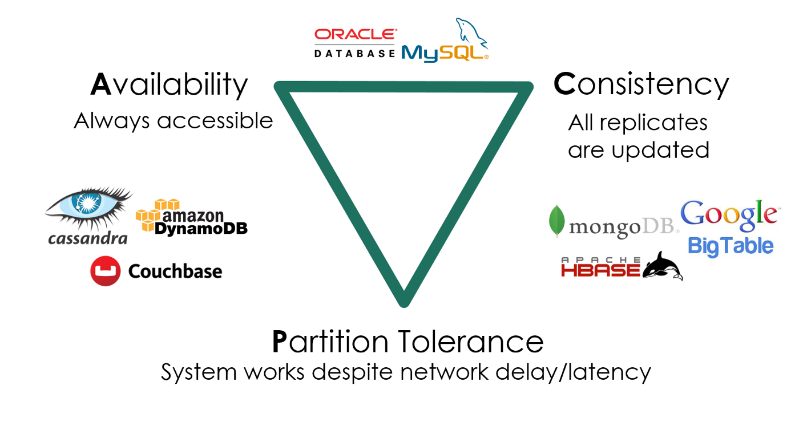
Main Challenges of Data Center
Highly Reliable and Low-Latency Data Access in Multi-Replica Systems
Serving massive, geographically distributed requests
Data must remain consistent (Consistency)
Services must always be available (Availability)
Must tolerate machine failures (Partition Tolerance)

Slide 33
How to Maximize Parallel Request Handling with a Single Machine
Key Metrics: QPS, Tail Latency, ...
Tools We Have
Threads
Coroutines
Multiple execution flows that can be paused/resumed (M2 - libco)
More lightweight than threads (no system calls, thus no OS state)
GO
Threads + Coroutines
thread(start = true) {
println("${Thread.currentThread()} has run.")
}

Slide 34
Concurrent Programming Around Us
Web 2.0 Era (1999)
The Internet that connects people more closely.
“Users were encouraged to provide content, rather than just viewing it.”
You can even find some traces of “Web 3.0” / Metaverse.
What Enabled Today’s Web 2.0?
Concurrent Programming in Browsers: Ajax (Asynchronous JavaScript + XML)
HTML (DOM Tree) + CSS
Represent everything you can see
JavaScript
Modify the page content
Connect local and server resources
You have the whole world at your fingertips!

Slide 35
Features of Human-Computer Interaction
As few concurrent tasks as possible, but just enough to meet requirements.
One thread, a global event queue, and sequential execution.
Run-to-completion: Each task runs to completion before the next one starts.
Notes:
Make it as simple as possible

Slide 36
Concurrent Programming - Real-world Applications
High-Performance Computing
Focus: Task Decomposition
Pattern: Producer-Consumer
Technologies: MPI / OpenMP
Data Centers
Focus: System Calls
Pattern: Threads-Coroutines
Technologies: Goroutine
Human-Computer Interaction
Focus: Usability
Pattern: Event-Stream Graph
Technologies: Promise.

Slide 37

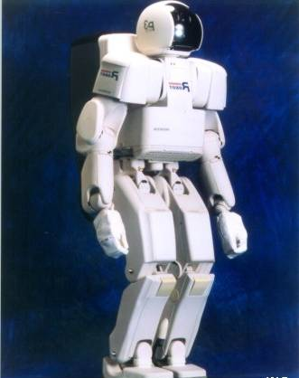
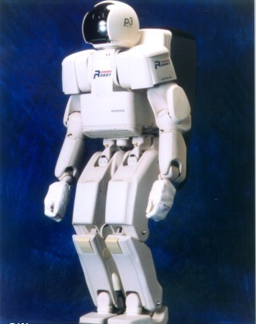
Motivating Example: Too Much Milk
Two robots are programmed to maintain the milk inventory at a store…
They are not aware of each other’s presence…
Robot: Dumb
Robot: Dumber

Slide 38
Motivating Example: Too Much Milk
Dumb
10:00 Look into fridge:
Out of milk
Dumber

Slide 39
Motivating Example: Too Much Milk
Dumb
10:00 Look into fridge:
Out of milk
10:05 Head for the warehouse
Dumber

Slide 40
Motivating Example: Too Much Milk
Dumb
10:05 Head for the warehouse
Dumber
10:10 Look into fridge:
Out of milk

Slide 41
Motivating Example: Too Much Milk
Dumb
Dumber
10:10 Look into fridge:
Out of milk
10:15 Head for the warehouse

Slide 42
Motivating Example: Too Much Milk
Dumb
10:20 Arrive with milk
Dumber
10:15 Head for the warehouse

Slide 43

Motivating Example: Too Much Milk
Dumb
10:20 Arrive with milk
Dumber
10:15 Head for the warehouse

Slide 44
Motivating Example: Too Much Milk
Dumb
10:20 Arrive with milk
10:25 Go party
Dumber

Slide 45
Motivating Example: Too Much Milk
Dumb
10:20 Arrive with milk
10:25 Go party
Dumber
10:30 Arrive with milk: “Uh oh…”

Slide 46
Definitions
Synchronization: uses atomic operations to ensure cooperation among threads
Mutual exclusion: ensures one thread can do something without the interference of other threads
Critical section: a piece of code that only one thread can execute at a time

Slide 47
More on Critical Section
A lock prevents a thread from doing something
A thread should lock before entering a critical section
A thread should unlock when leaving the critical section
A thread should wait if the critical section is locked
Synchronization often involves waiting

Slide 48
Too Much Milk: Solution 1
Two properties:
Only one robot will go get milk
Someone should go get the milk if needed
Basic idea of solution 1
Leave a note (kind of like a lock)
Remove the note (kind of like a unlock)
Don’t go get milk if the note is around (wait)

Slide 49
Too Much Milk: Solution 1
if (no milk) {
if (no note) {
// leave a note;
// go get milk;
// remove the note;
}
}

Slide 50
Too Much Milk: Solution 1
Dumb
10:00 if (no milk) {
Dumber

Slide 51
Too Much Milk: Solution 1
Dumb
10:00 if (no milk) {
Dumber
10:01 if (no milk) {

Slide 52
Too Much Milk: Solution 1
Dumb
10:00 if (no milk) {
Dumber
10:01 if (no milk) {
10:02 if (no note) {

Slide 53
Too Much Milk: Solution 1
Dumb
10:00 if (no milk) {
10:03 if (no note) {
Dumber
10:01 if (no milk) {
10:02 if (no note) {

Slide 54

Too Much Milk: Solution 1
Dumb
10:00 if (no milk) {
10:03 if (no note) {
10:04 // leave a note
Dumber
10:01 if (no milk) {
10:02 if (no note) {

Slide 55
Too Much Milk: Solution 1
Dumb
10:03 if (no note) {
10:04 // leave a note
Dumber
10:01 if (no milk) {
10:02 if (no note) {
10:05 // leave a note

Slide 56
Too Much Milk: Solution 1
Dumb
10:03 if (no note) {
10:04 // leave a note
10:06 // go get milk
Dumber
10:02 if (no note) {
10:05 // leave a note

Slide 57
Too Much Milk: Solution 1
Dumb
10:03 if (no note) {
10:04 // leave a note
10:06 // go get milk
Dumber
10:05 // leave a note
10:07 // go get milk

Slide 58
Too Much Milk: Solution 2
Okay…solution 1 does not work
The notes are posted too late…
What if both robots begin by leaving their own notes?

Slide 59
Too Much Milk: Solution 2
// leave a note;
if (no note from the other) {
if (no milk) {
// go get milk;
}
}
// remove the note;

Slide 60
Too Much Milk: Solution 2
Dumb
10:00 // leave a note
Dumber

Slide 61
Too Much Milk: Solution 2
Dumb
10:00 // leave a note
Dumber
10:01 // leave a note

Slide 62
Too Much Milk: Solution 2
Dumb
10:00 // leave a note
10:02 if (no note from Dumber) {…}
Dumber
10:01 // leave a note

Slide 63
Too Much Milk: Solution 2
Dumb
10:00 // leave a note
10:02 if (no note from Dumber) {…}
Dumber
10:01 // leave a note
10:03 if (no note from Dumb) {…}

Slide 64
Too Much Milk: Solution 2
Dumb
10:00 // leave a note
10:02 if (no note from Dumber) {…}
10:04 // remove the note
Dumber
10:01 // leave a note
10:03 if (no note from Dumb) {…}

Slide 65
Too Much Milk: Solution 2
Dumb
10:00 // leave a note
10:02 if (no note from Dumber) {…}
10:04 // remove the note
Dumber
10:01 // leave a note
10:03 if (no note from Dumb) {…}

Slide 66
Too Much Milk: Solution 2
Dumb
10:02 if (no note from Dumber) {…}
10:04 // remove the note
Dumber
10:01 // leave a note
10:03 if (no note from Dumb) {…}
10:05 // remove the note

Slide 67
Too Much Milk: Solution 2
Dumb
10:02 if (no note from Dumber) {…}
10:04 // remove the note
Dumber
10:01 // leave a note
10:03 if (no note from Dumb) {…}
10:05 // remove the note

Slide 68
Too Much Milk: Solution 2
Solution 2 does not work
The notes are found too late…
What if both robots wait for the other to leave a note?

Slide 69
Too Much Milk: Solution 3
Dumb
// leave Dumb’s note
while (Dumber’s note) { };
if (no milk) {
// go get milk
}
// remove Dumb’s note
Dumber
// leave Dumber’s note
if (no Dumb’s note) {
if (no milk) {
// go get milk
}
}
// remove Dumber’s note

Slide 70
Too Much Milk Solution 3
How do we verify the correctness of a solution?
Test arbitrary interleaving of locking and checking locks
In this case, leaving notes and checking notes

Slide 71
Dumber Challenges Dumb: Case 1
Dumb
// leave Dumb’s note
while (Dumber’s note) { };
if (no milk) {
// go get milk
}
// remove Dumb’s note
Dumber
// leave Dumber’s note
if (no Dumb’s note) {
}
// remove Dumber’s note
Time

Slide 72
Dumber Challenges Dumb: Case 2
Dumb
// leave Dumb’s note
while (Dumber’s note) { };
if (no milk) {
// go get milk
}
// remove Dumb’s note
Dumber
// leave Dumber’s note
if (no Dumb’s note) {
}
// remove Dumber’s note
Time

Slide 73
Dumber Challenges Dumb: Case 3
Dumb
// leave Dumb’s note
while (Dumber’s note) { };
if (no milk) {
// go get milk
}
// remove Dumb’s note
Dumber
// leave Dumber’s note
if (no Dumb’s note) {
}
// remove Dumber’s note
Time

Slide 74
Dumb Challenges Dumber: Case 1
Dumb
// leave Dumb’s note
while (Dumber’s note) { };
if (no milk) {
}
// remove Dumb’s note
Dumber
// leave Dumber’s note
if (no Dumb’s note) {
if (no milk) {
// go get milk
}
}
// remove Dumber’s note
Time

Slide 75
Dumb Challenges Dumber: Case 2
Dumb
// leave Dumb’s note
while (Dumber’s note) { };
if (no milk) {
// go get milk
}
// remove Dumb’s note
Dumber
// leave Dumber’s note
if (no Dumb’s note) {
}
// remove Dumber’s note
Time

Slide 76
Dumb Challenges Dumber: Case 3
Dumb
// leave Dumb’s note
while (Dumber’s note) { };
if (no milk) {
// go get milk
}
// remove Dumb’s note
Dumber
// leave Dumber’s note
if (no Dumb’s note) {
}
// remove Dumber’s note
Time

Slide 77
Lessons Learned
Although it works, Solution 3 is ugly
Difficult to verify correctness
Two threads have different code
Difficult to generalize to N threads
While Dumb is waiting, it consumes CPU time (busy waiting)
More elegant with higher-level primitives
lock→acquire();
if (no milk) { // go get milk }
lock→release();

Slide 78
Takeaways
Independent Threads
Cooperating Threads
Race Condition
Loss of Atomicity
Synchronization

